Slide 1

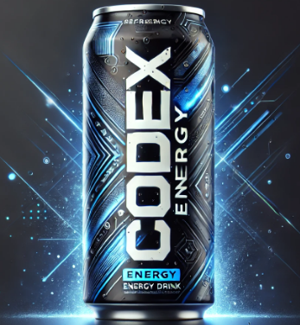

Market Insights for CodeX Energy Drink
Codebasics Resume Challenge – 6
Presented by:Pratibha Sahu

Slide 2
Contents
Introduction
Goals
Problem Statement & Insights
Recommendation

Slide 3
INTRODUCTION
CodeX is a German energy drink brand designed for a quick energy boost. It contains vitamins, caffeine, and natural ingredients to keep people active. A few months ago, CodeX launched in 10 Indian cities, targeting young professionals, students, and athletes. With India’s fast-growing energy drink market, CodeX aims to become a top choice by understanding customer needs and using smart marketing.

Slide 4
GOALS
Improve Market Share
Increase Brand Awareness
Enhance Product Development
Optimize Marketing Strategies

Slide 5
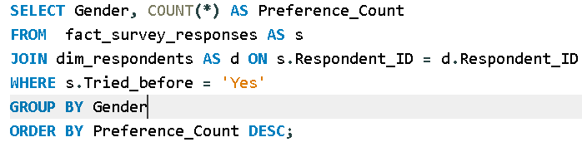
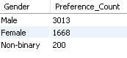
1. Demographic Insights A. Who Prefers Energy Drink More? (Male/Female/Non-binary?)
query
output

Slide 6
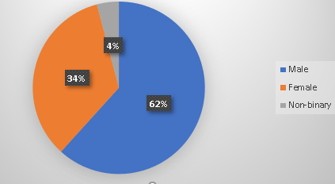
VISUAL
INSIGHTS
Males prefer energy drinks more than females. The preference count for males is 3013, for females is 1668, and for non-binary individuals is 200. This data suggests a significant gender gap in energy drink consumption, with males being the dominant consumers.

Slide 7
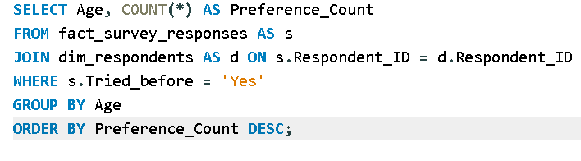
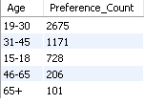
B. Which Age Group Prefers Energy Drinks More?
QUERY
OUTPUT

Slide 8
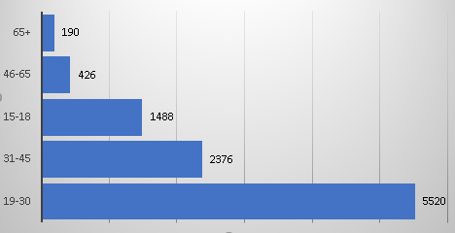
VISUAL
INSIGHTS
VISUAL
The 19-30 age group consumes the most energy drinks.
Consumption decreases significantly with each older age bracket.
The oldest age group (65+) has the lowest energy drink consumption.

Slide 9
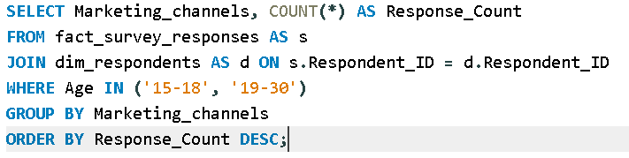
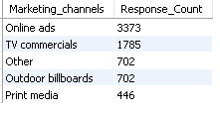
C. Which Type Of Marketing Reaches The Most Youth (15-30)?
QUERY
OUTPUT

Slide 10
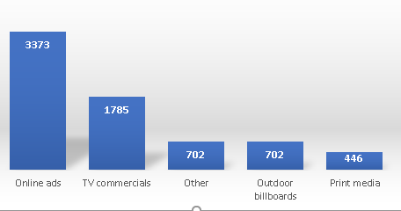
VISUAL
INSIGHTS
Online ads are the most effective marketing channel to reach youth aged 15-30, with a response count of 3373. TV commercials are the second most effective with 1785 responses. Other methods, outdoor billboards, and print media have significantly lower reach in comparison

Slide 11
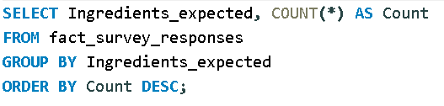
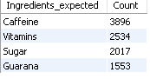
2. Consumer Preferences: A. What Are The Preferred Ingredients Of Energy Drinks Among Respondents?
QUERY
OUTPUT

Slide 12
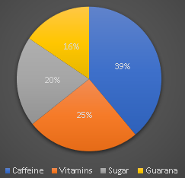
VISUAL
INSIGHTS
Caffeine is the most desired ingredient in energy drinks among respondents.
Vitamins are also a popular choice, preferred more than sugar.
Guarana is the least favored ingredient among the options listed.

Slide 13
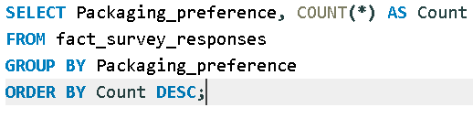
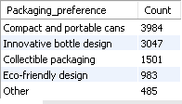
B. What Packaging Preferences Do Respondents Have For Energy Drinks?
QUERY
OUTPUT

Slide 14
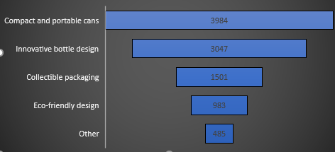
VISUAL
INSIGHTS
Compact and portable cans are the most preferred packaging for energy drinks, with 3,984 respondents choosing them.
Innovative bottle design is the second most popular, followed by collectible packaging and eco-friendly design.
Eco-friendly design and other options have the least preference, indicating sustainability isn't a top concern yet.

Slide 15
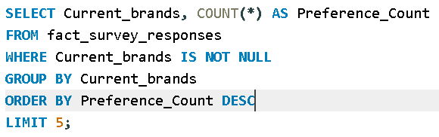
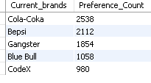
3. Competition Analysis: A. Who Are The Current Market Leaders?
QUERY
OUTPUT

Slide 16
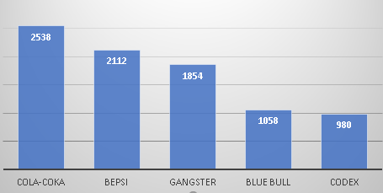
VISUAL
INSIGHTS
Cola-Coka is the most preferred brand with 2538 preferences, followed by Bepsi with 2112 preferences. Gangster is the third most preferred brand with 1854 preferences.

Slide 17
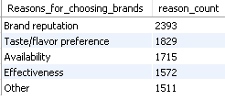
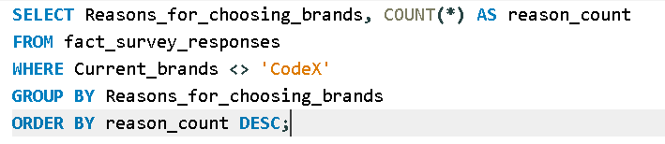
B. What Are The Primary Reasons Consumers Prefer Those Brands Over Ours?
QUERY
OUTPUT

Slide 18
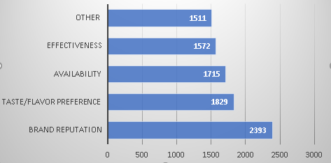
VISUAL
INSIGHTS
Brand reputation is the most important reason for consumers to choose other brands over Codex, followed by taste/flavor preference and availability. Effectiveness and other factors are also important, but less so than the top three reasons.

Slide 19
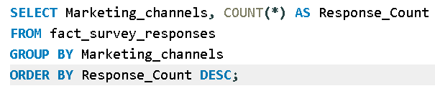
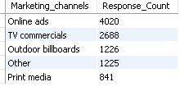
4. Marketing Channels And Brand Awareness: a. Which Marketing Channel Can Be Used To Reach More Customers?
QUERY
OUTPUT

Slide 20
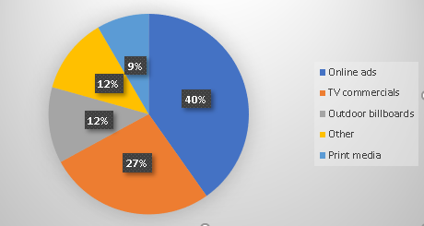
VISUAL
INSIGHTS
Online ads are the most effective marketing channel, reaching 4020 customers. TV commercials are the second most effective, reaching 2688 customers. Other channels, such as outdoor billboards and print media, have significantly lower reach.

Slide 21
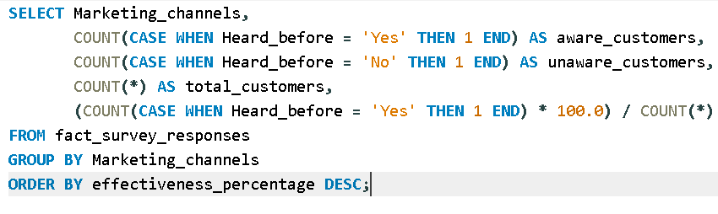
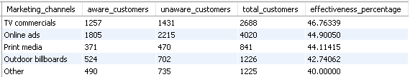
B. How Effective Are Different Marketing Strategies And Channels In Reaching Our customers?
QUERY
OUTPUT

Slide 22
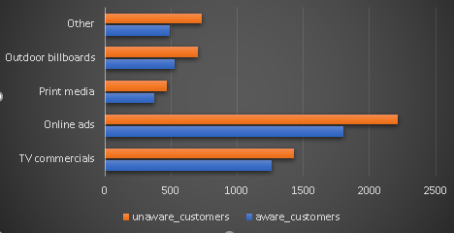
VISUAL
INSIGHTS
Online ads have the highest reach, making the most customers aware, but they also have the highest number of unaware customers, which means targeting can be improved. TV commercials are effective, but many customers are still unaware, so better messaging or increased frequency might help. Print media has the lowest impact, making it a less effective investment compared to digital or TV advertising.

Slide 23
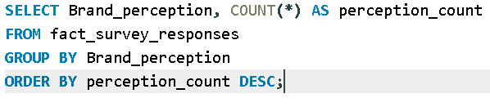
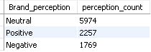
5. Brand Penetration: A. What Do People Think About Our Brand? (Overall Rating)
QUERY
OUTPUT

Slide 24
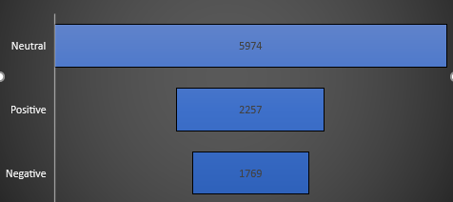
VISUAL
INSIGHTS
The most common perception of the brand is neutral, with 5974 people having this opinion. Positive and negative perceptions are less common, with 2257 and 1769 people respectively having these opinions.

Slide 25
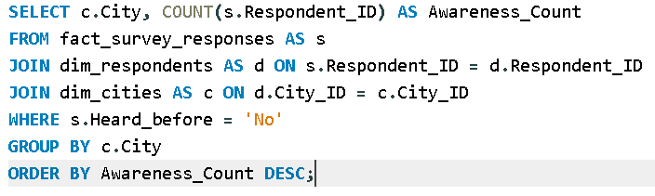
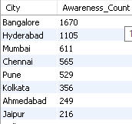
B. Which Cities Do We Need To Focus More On?
QUERY
OUTPUT

Slide 26
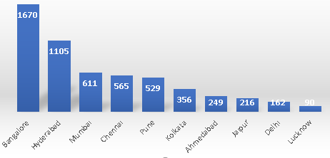
VISUAL
INSIGHTS
Bangalore has the highest awareness count with 1670, followed by Hyderabad with 1105. Mumbai, Chennai, and Pune have the next highest awareness counts, with 611, 565, and 529 respectively. These cities should be the focus of marketing efforts to increase brand awareness.

Slide 27
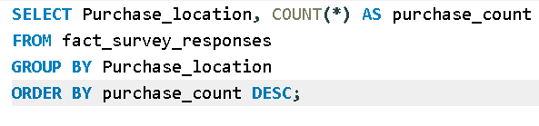
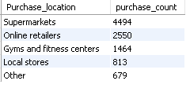
6. Purchase Behavior: A. Where Do Respondents Prefer To Purchase Energy Drinks?
QUERY
OUTPUT

Slide 28
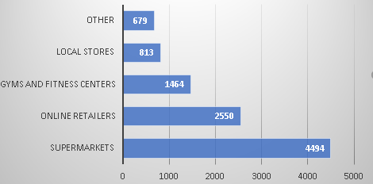
VISUAL
INSIGHTS
Supermarkets are the most preferred location for purchasing energy drinks, with 4494 respondents choosing them. Online retailers are the second most preferred location with 2550 respondents. Gyms and fitness centers, local stores, and other locations have significantly lower purchase counts.

Slide 29
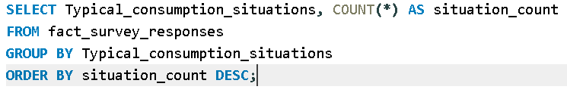
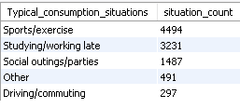
B. What Are The Typical Consumption Situations For Energy Drinks Among respondents?
QUERY
OUTPUT

Slide 30
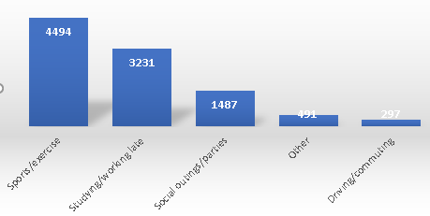
visual
insights
Sports/exercise is the most common consumption situation for energy drinks, with 4494 respondents choosing it. Studying/working late is the second most common situation with 3231 respondents. Social outings/parties, other activities, and driving/commuting have significantly lower consumption counts.

Slide 31
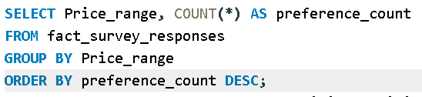
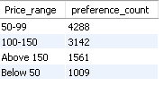
C. What factors influence respondents' purchase decisions, such as price range and limited edition packaging?
SQL Query to Analyze Preferred Price Range
output

Slide 32
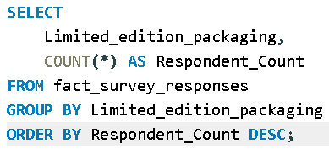
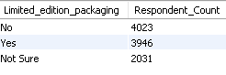
SQL query for the Influence of Limited Edition Packaging
Output

Slide 33
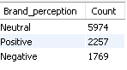
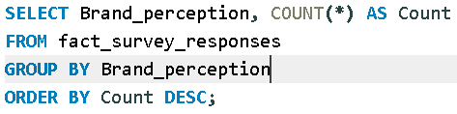
7. Product development a. Which area of business should we focus more on our product development? (Branding/taste/availability)
Brand analysis
OUTPUT

Slide 34
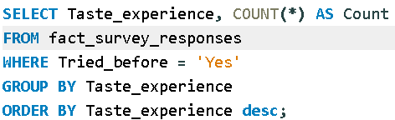
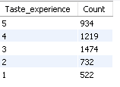
Taste Experience Analysis
OUTPUT

Slide 35
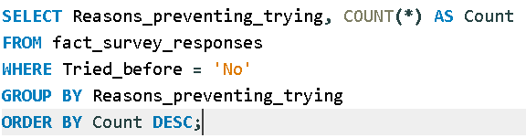
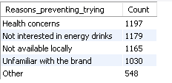
Availability Issue Analysis
OUTPUT

Slide 36
RESULT
Brand Perception Insight: Most respondents have a neutral or positive view of the brand, indicating room for stronger branding efforts.
Taste Experience Insight: A majority rate the taste highly (3 or 4), meaning taste is a strong point, but lower ratings suggest potential for improvement.
Availability Issue Insight: The biggest barrier is health concerns in certain areas, so add more natural ingredients, reduce sugar content and add more flavours.

Slide 37


Recommendations for CodeX:
What immediate improvements can we bring to the product?
Improve Availability
📌 Insight: If "Not available locally" is a major reason preventing trials, CodeX must strengthen distribution.
✅ Action: Expand presence in supermarkets, gyms, and online platforms where energy drinks are commonly purchased.

Slide 38
What should be the ideal price of our product?
📌 Insight: If most consumers prefer the 50-99 INR range, pricing above this may limit reach.
✅ Action:Keep the price affordable (₹50-99) to attract more buyers.Offer introductory discounts or bundle deals for first-time buyers.

Slide 39
What kind of marketing campaigns, offers, and discounts we can run?
📌 Insight: If many respondents haven't heard of CodeX, stronger branding is needed.
✅ Action: Run influencer marketing with fitness trainers, students, and professionals who consume energy drinks. Use Instagram Reels, YouTube Shorts, and gym sponsorships to reach the right audience.

Slide 40



Who can be a brand ambassador, and why?
📌 Insight: If consumers use energy drinks for sports performance, work/study focus, and fatigue relief, a brand ambassador should reflect this.
✅ Action:Collaborate with top athletes like Virat Kohli, Neeraj Chopra, and MS Dhoni who inspire fitness, discipline, and peak performance. These sports icons resonate with a broad audience, making them ideal brand ambassadors for energy drinks or fitness-related products.

Slide 41


Who should be our target audience, and why?
🎯 Primary Target Audience: Youth aged 15 to 30, including students, young professionals, and gamers who seek energy drinks for focus, performance, and socializing.
✅ Action Plan: Focus on youth-centric marketing strategies such as student discounts, sponsorship of college festivals and esports events, influencer collaborations, and trendy packaging to attract young consumers.

Slide 42
THANK YOU

